Slide 1

SCB Hackthon GRADS’23
Presented by: Team Gullak
Members: Kusmakar Pathak
Manish Sharma
Mihir Ranjan
Raj Karan Kumar
Rishika Meel

Slide 2

Problem Statement:
Create a Financial Advisory recommendation System

Slide 3
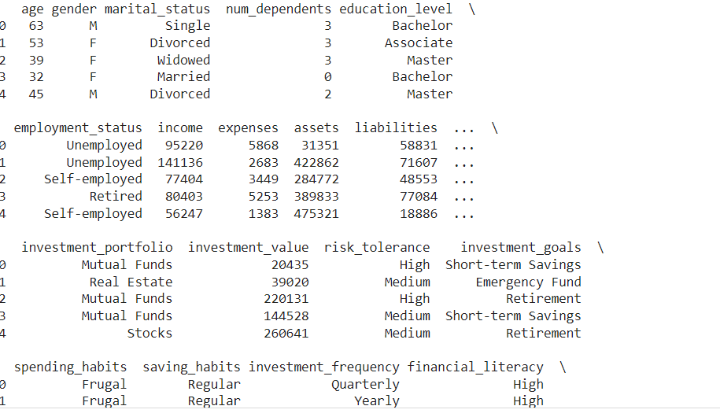
Data Analysis:
We created a dataset which consits of 10,000 rows which consist of information about demoraphic data, financial data,Investment data, Behavioural data of users.

Slide 4
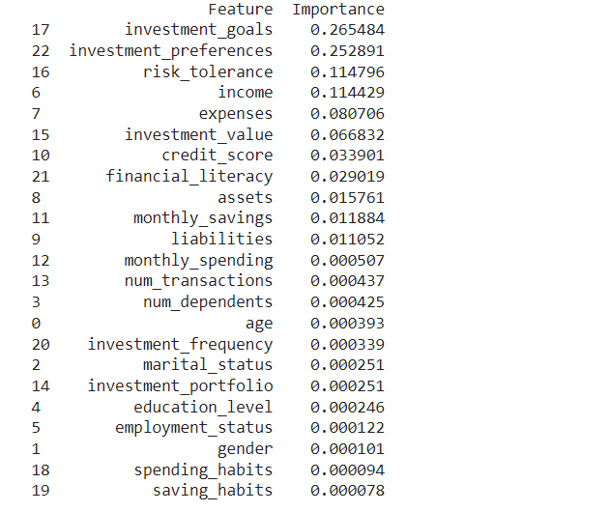
Relation of various features TO Give Advice
Looked for the correlation of various features with the target variable

Slide 5

Insights from the correlation
Investment goal has the highest positive correlation
Investment Preference has the second highest positive correlation
Income, risk tolerance, assests, liabilities, Credit score these are also some important features on the basis of which our model will give financial advisory recommendation

Slide 6
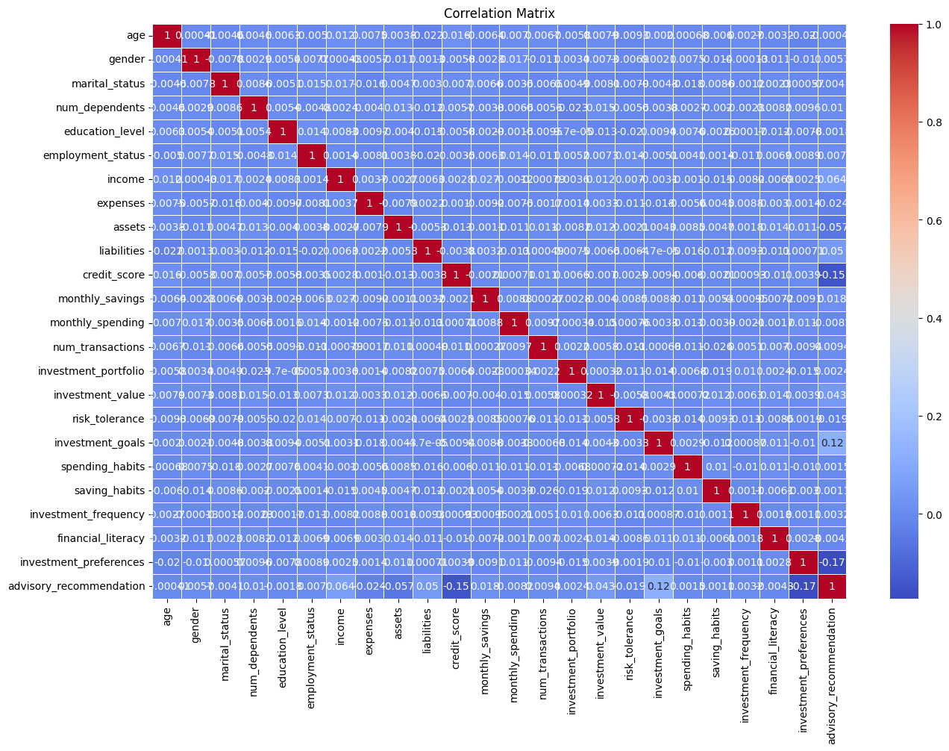
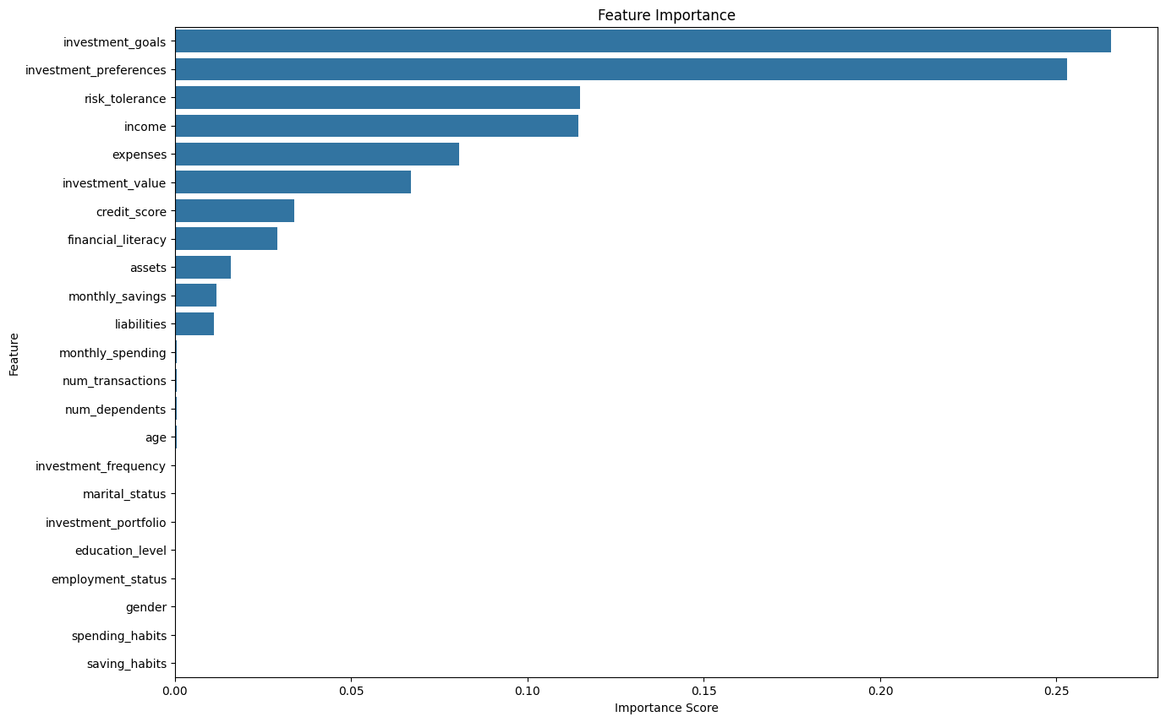
Some Relational Graphs

Slide 7
Data Pre-Processing/ Feature Extraction
Performed Exploratory Data Analysis on our dataset to gain some insights about the null values, Outliers, and relation of different independent variable with the target variable
We had a very balanced dataset

Slide 8
Training ML Models

Slide 9
Performance of ML Models
Trained our model on various algorithms such as Logistic Regression, Random Forest Classifier, ANN, Adaboost, Xgboost
We tried different types of models as you can see above in which Xgboost outperforms all of them
ML Model | Accuracy
Logistic Regression | 96%
Random Forest | 97.33%
Adaboost | 98.68%
ANN | 98.72%
Xgboost | 99.9%

Slide 10

Scope of Improvement
Can fine- tune ANN model by experimenting with number of layers, neurons & other hyper-parameters
Since we had the limitation of dataset from every aspect say it demographic, financial. Since it’s not a real dataset our model can be biased and not well trained. Having Access of real world dataset we can create more realistic model
Can try other ways to fill NaN values like filling with median/mode or using linear interpolation
Can try different normalization techniques like Min-Max Normalization & Median and inter-quartile range normalization
Can do Hyperparameter Optimization for Xgboost

Slide 11

Recommendations & Results
XGBoost was the best classifier with an accuracy of almost 99.9%
Features like count_of_emi_before, revolve_1m, credit_limit are of most importance
People of young age has higher risk tolerance so they can invest more in variable component rather than fixed deposits
In General We observed one thing it’s risk tolerance also plays an important role. So going for any investment strategy people should diversify their portifolio to mitigate risk factor

Slide 12

THANK YOU

